Slide 1
Flood Frequency Analysis

Slide 2
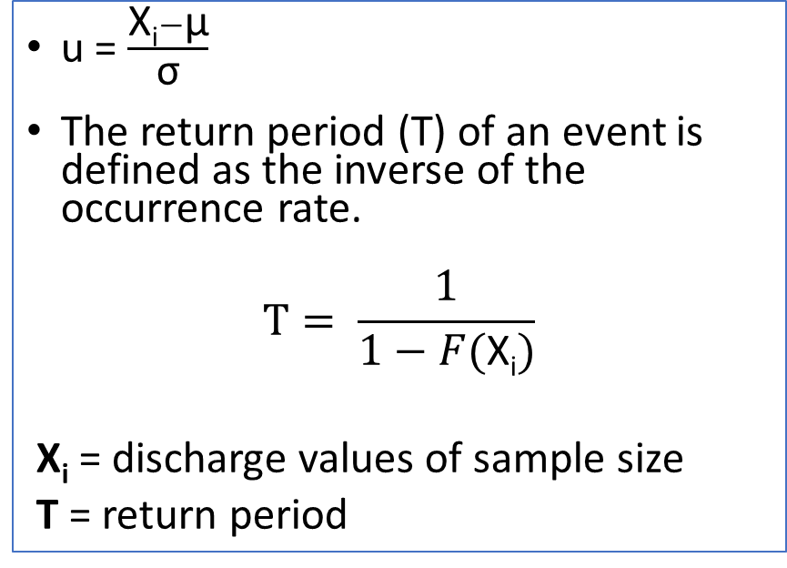
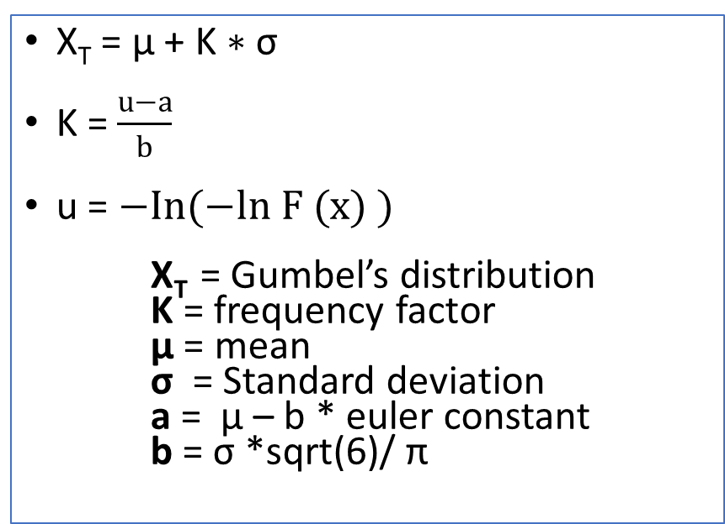
Methods
Gumbel distribution
Normal Distribution
X_{T} = µ + K ∗ σ
K = $\frac{u−a}{b}$
u = $−In(−ln F (x) )$
X_{T} = Gumbel’s distribution K = frequency factor μ = mean σ = Standard deviation a = μ – b * euler constant b = σ *sqrt(6)/ π
u = $\frac{\text{X}\text{i}−\text{µ}}{\text{σ}}$
The return period (T) of an event is defined as the inverse of the occurrence rate.
$$T= \frac{1}{1−F(\text{X}\text{i})}$$
$\text{X}\text{i}$ = discharge values of sample size
T = return period

Slide 3
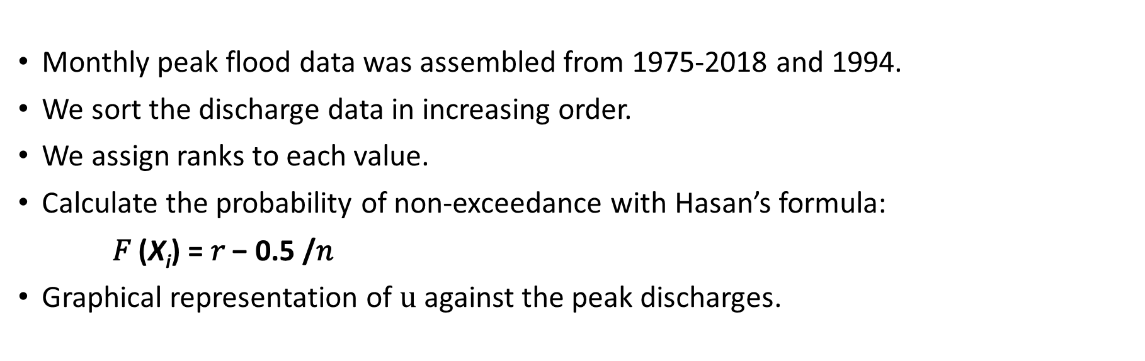
Procedure
Monthly peak flood data was assembled from 1975-2018 and 1994.
We sort the discharge data in increasing order.
We assign ranks to each value.
Calculate the probability of non-exceedance with Hasan’s formula:
𝐹 ($\text{X}\text{i}$) = 𝑟 − 0.5 /𝑛
Graphical representation of $u$ against the peak discharges.

Slide 4
Flood analysis by Gumbel’s Distribution
Return period (years) | Frequency (%) | Reduced Variate(u) | Discharge(m3/s) (1975-2018) | Discharge (1994)
10 | 99.17 | 4.79 | 710.01 | 1672.1
20 | 99.59 | 5.48 | 804.24 | 1900.06
50 | 99.83 | 6.4 | 928.6 | 2201
100 | 99.92 | 7.08 | 1022.6 | 2428.4

Slide 5
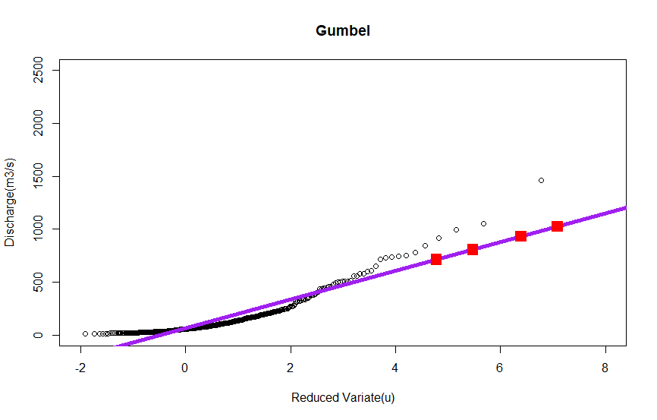
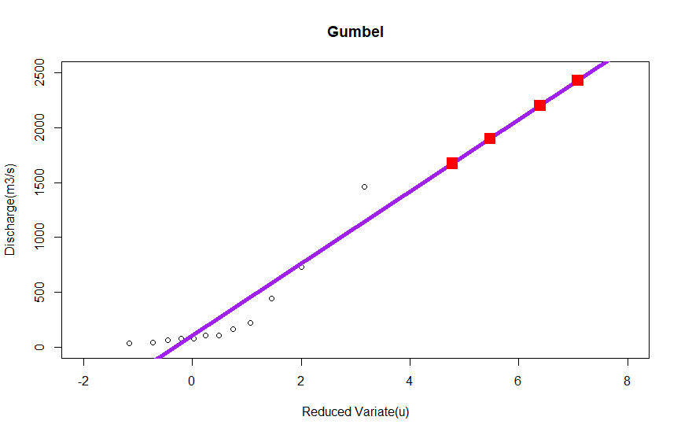
Flood analysis by Gumbel’s Distribution
Gumbel (1975-2018)
Gumbel (1994)

Slide 6
Flood analysis by Normal distribution
Return period (years) | Frequency (%) | Reduced Variate(u) | Discharge (1975-2018) | Discharge (1994)
10 | 99.17 | 4.79 | 556.1 | 1299.7
20 | 99.59 | 5.48 | 598.6 | 1402.43
50 | 99.83 | 6.4 | 650.17 | 1527.3
100 | 99.92 | 7.09 | 686.46 | 1615.1

Slide 7
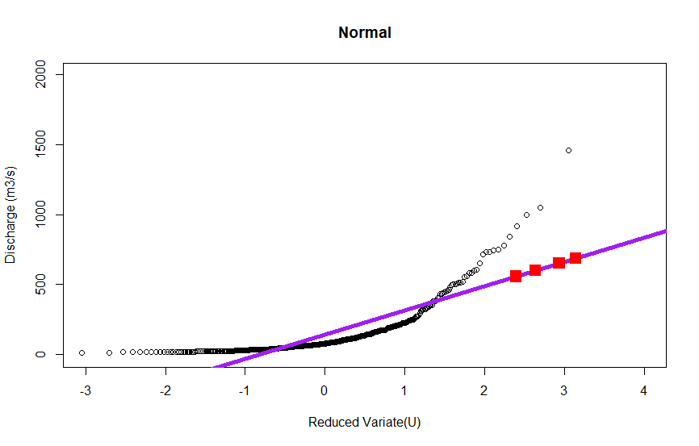
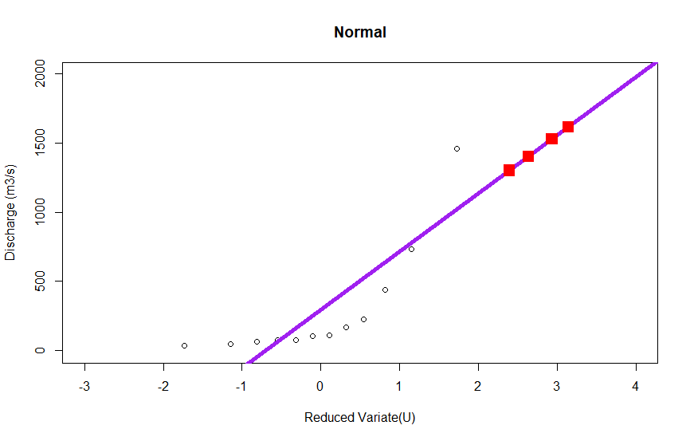
Flood analysis by Normal distribution
Normal (1975-2018)
Normal (1994)

Slide 8
Refernces
Gumbel, E.J. (1935), "Les valeurs extrêmes des distributions statistiques" (PDF), Annales de l'Institut Henri Poincaré, 5 (2) : 115–158.
A. Hazen et G.S. Williams, Hydraulic Tables, New York, John Wiley and Sons, 1920, 3e éd.

Slide 9
Thank you

